Slide 1
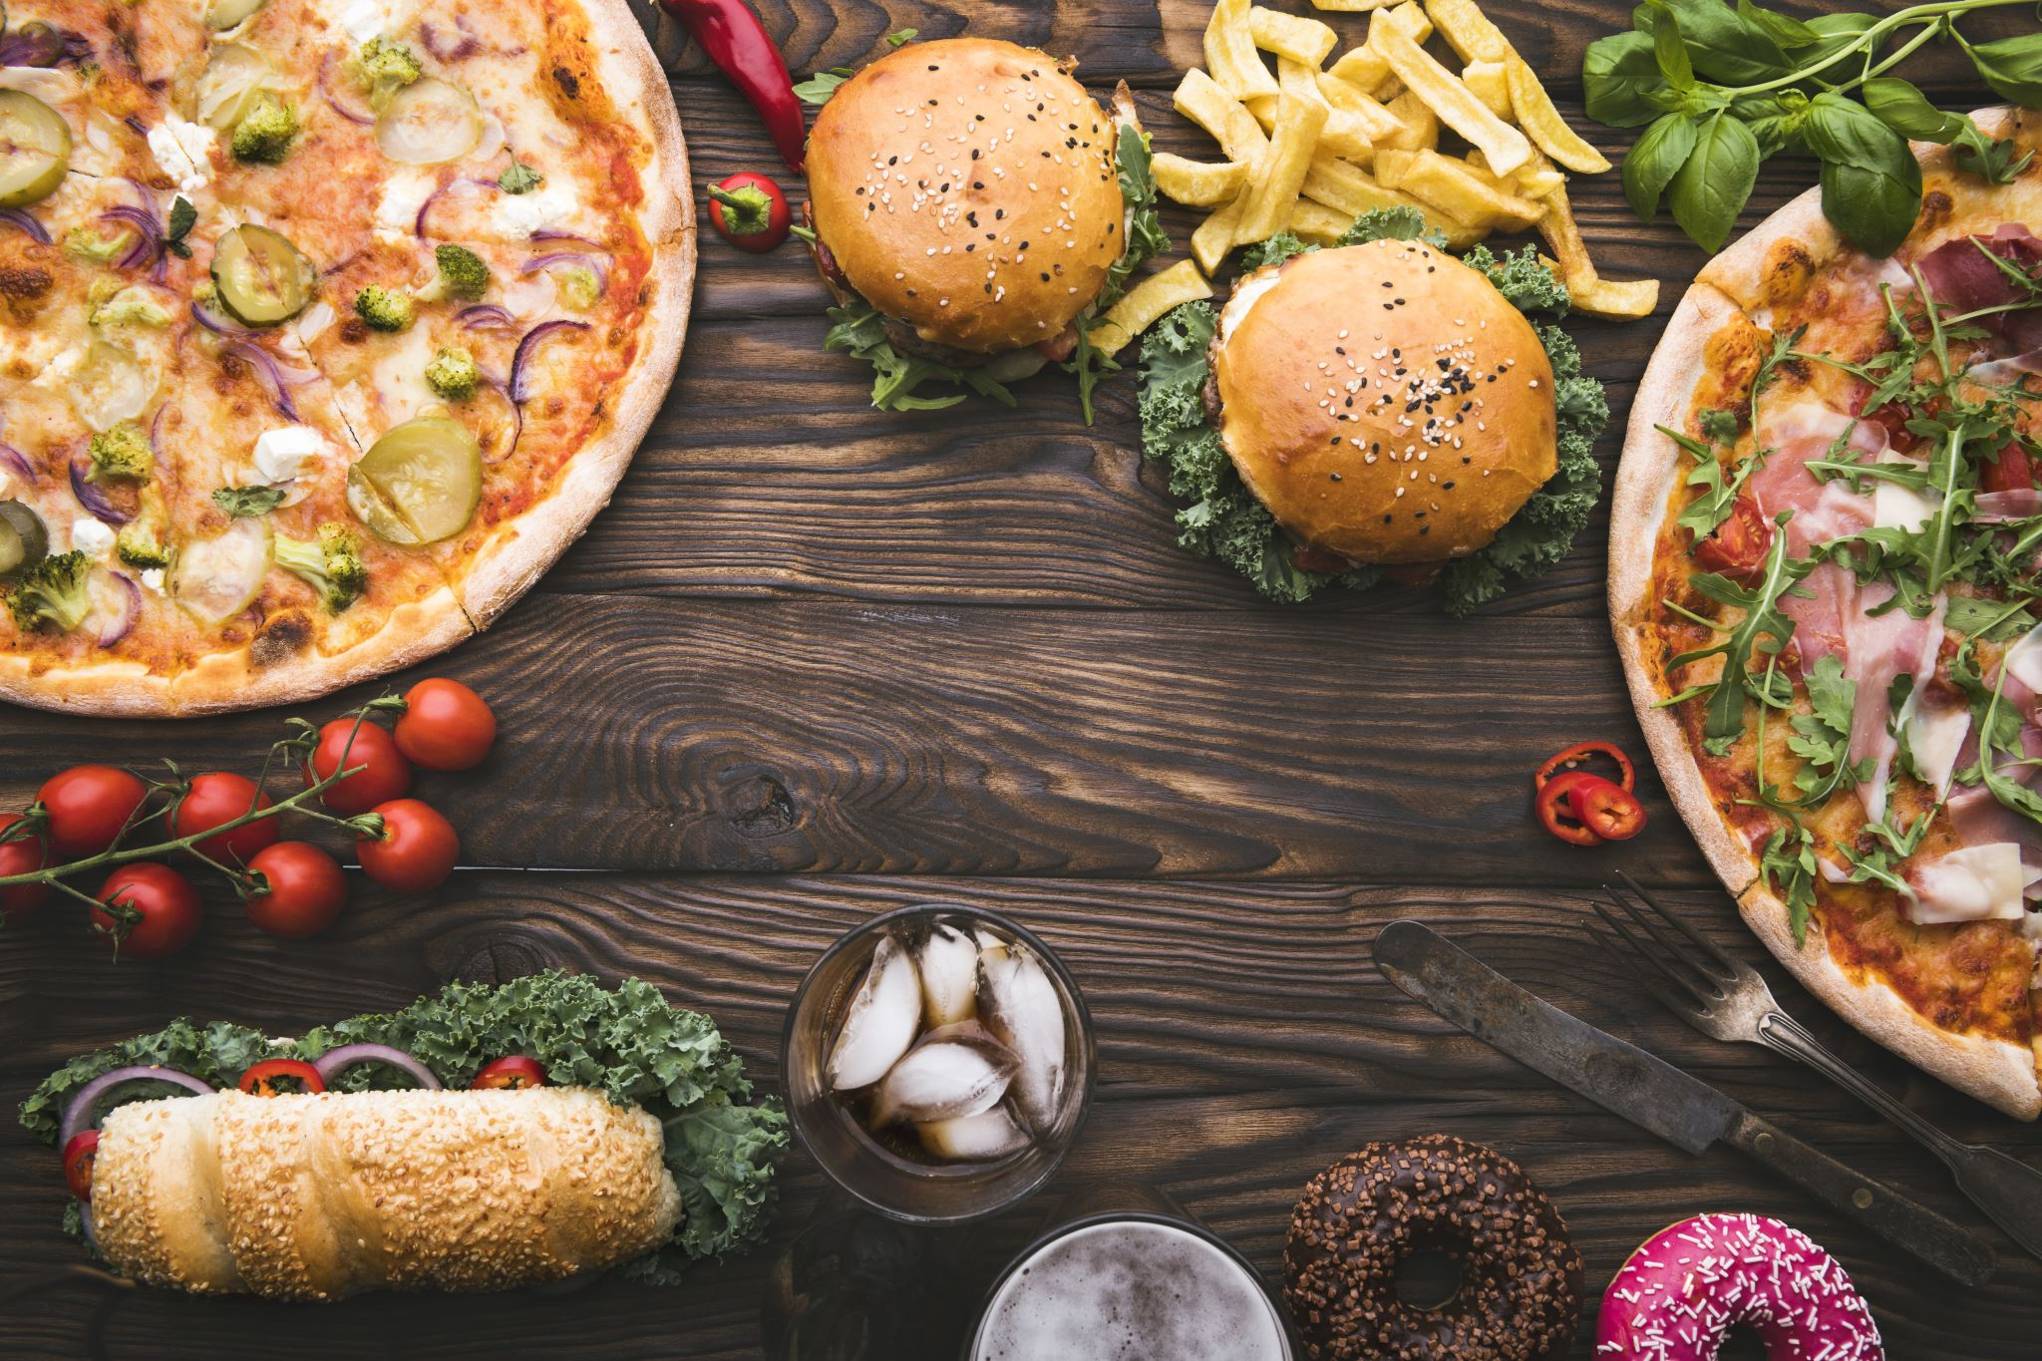
Pizza Sales Dashboard
Eng/Farah Samy

Slide 2
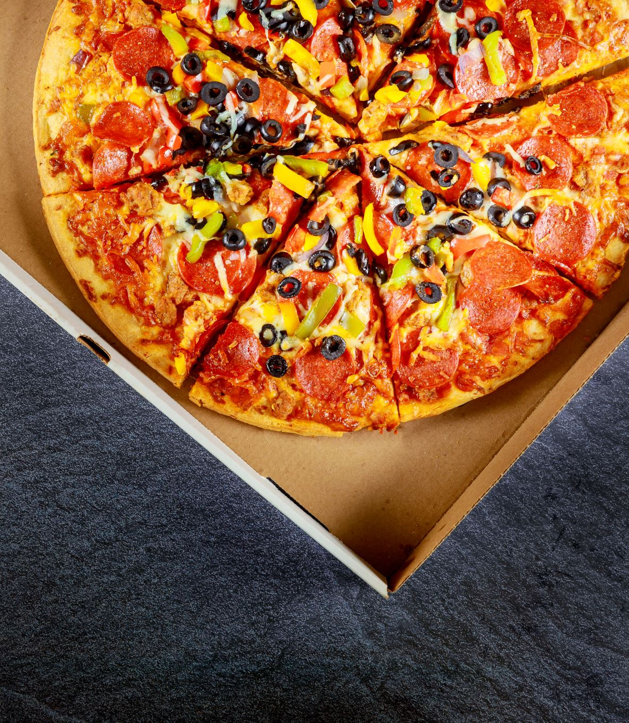
Exploring Key Questions:
Daily Customer Insights: How many customers do we have each day, and are there any peak hours that define our bustling traffic?
Order Dynamics: How many pizzas are typically in an order, and can we identify our bestsellers that have become crowd favorites?
Financial Snapshot: What is the monetary measure of our success this year, and can we uncover patterns that point towards seasonality in our sales?
Menu Optimization: Are there any pizzas that should gracefully exit our menu, or do we have opportunities to enhance sales through strategic promotions?

Slide 3

Dashboard

Slide 4
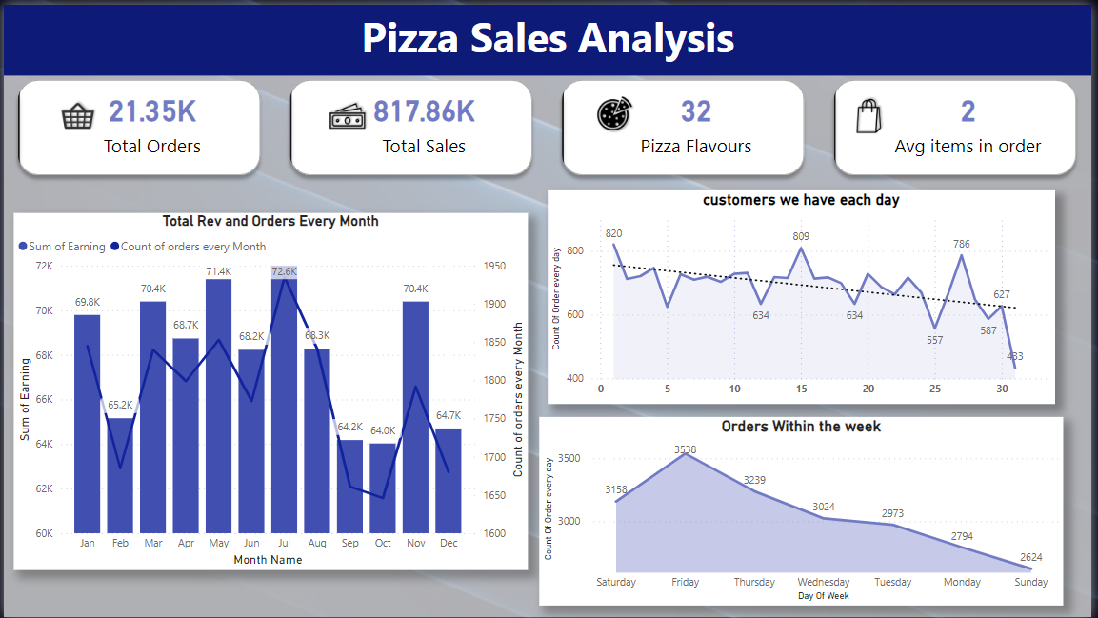
Sales Performance Overview

Slide 5
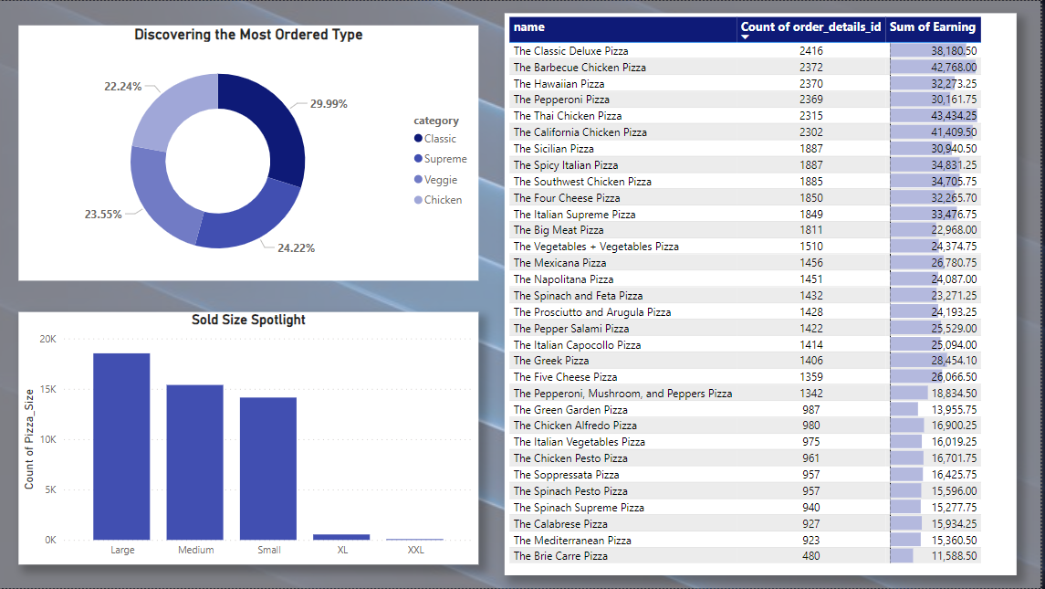
Top Performance

